Slide 1

The Value of Social Data
Tim Barker, Chief Product Officer, DataSift.
Confidential

Slide 2
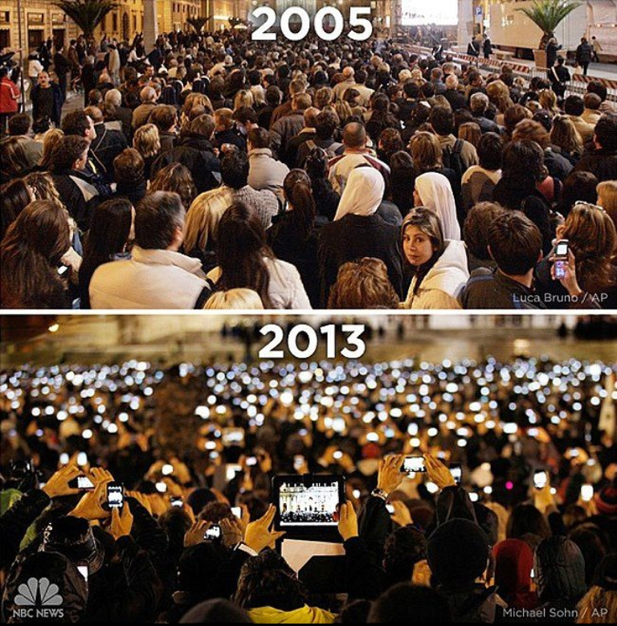

Slide 3
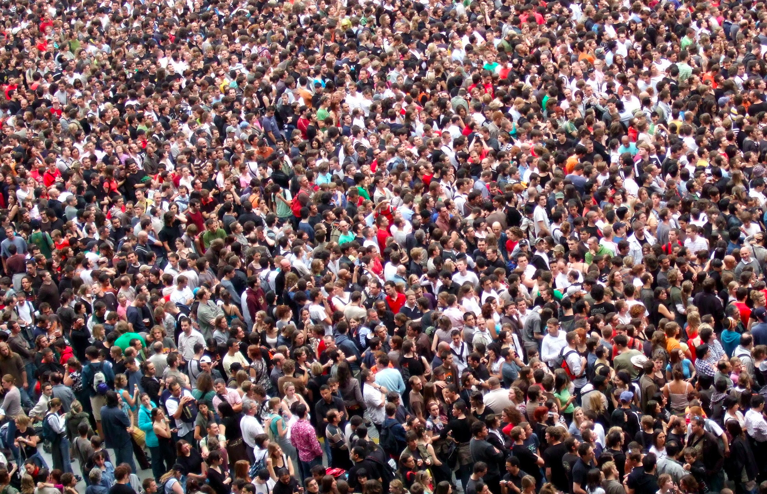



3.2 Bn
Likes
500M
Tweets
3.5M Posts and comments

Slide 4
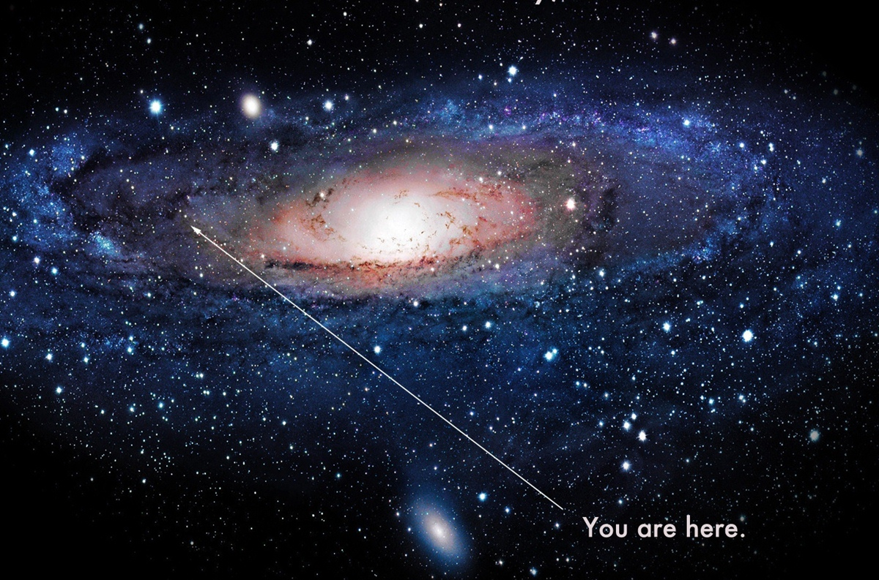
The digital universe transparent. observable. measurable

Slide 5
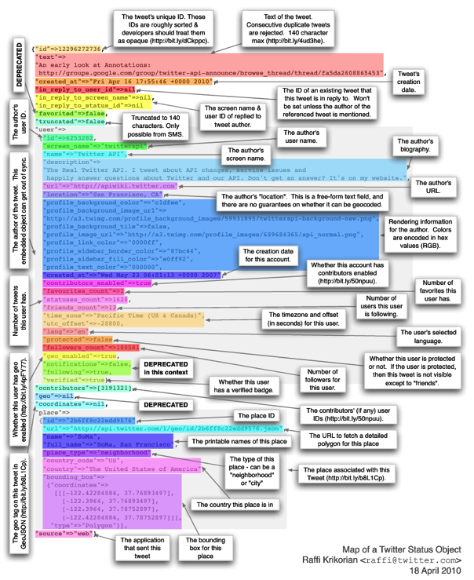
Tiny nuggets of customer insight
A single Tweet contains 120 items of data

Slide 6
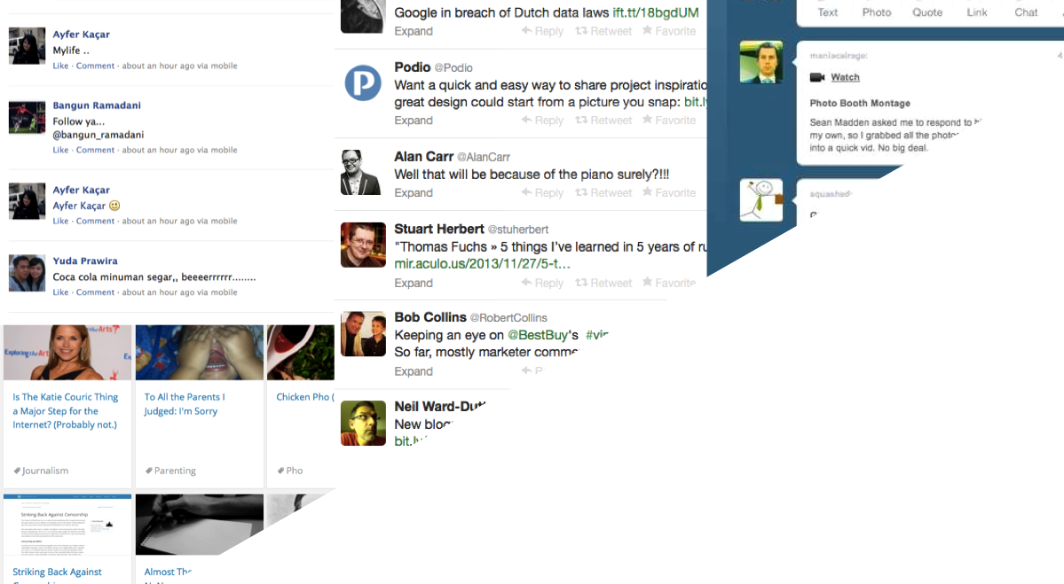
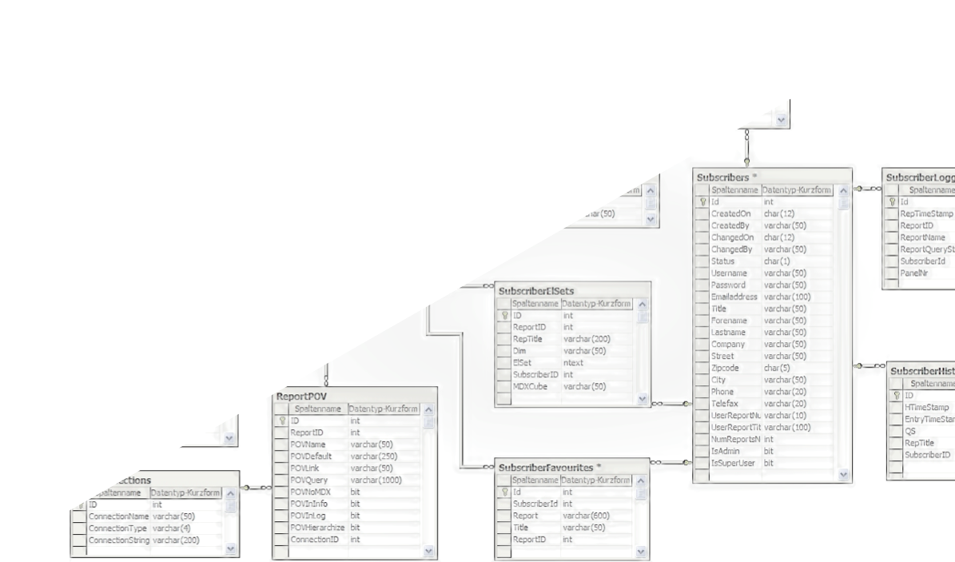
Big. Fast. Messy. Text.
Relevant. Data. Analyzable

Slide 7
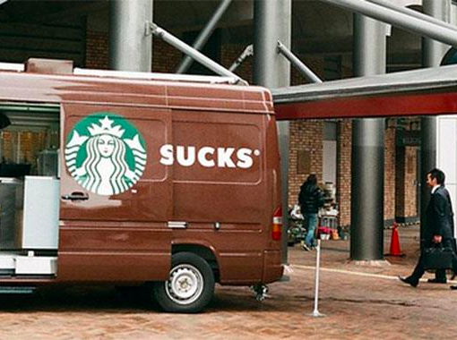
Companies started by monitoring their #brands

Slide 8
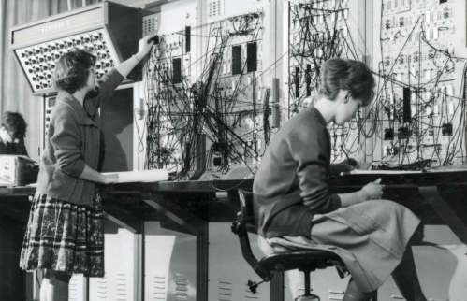
You can’t eyeball every Tweet, Post & Comment

Slide 9
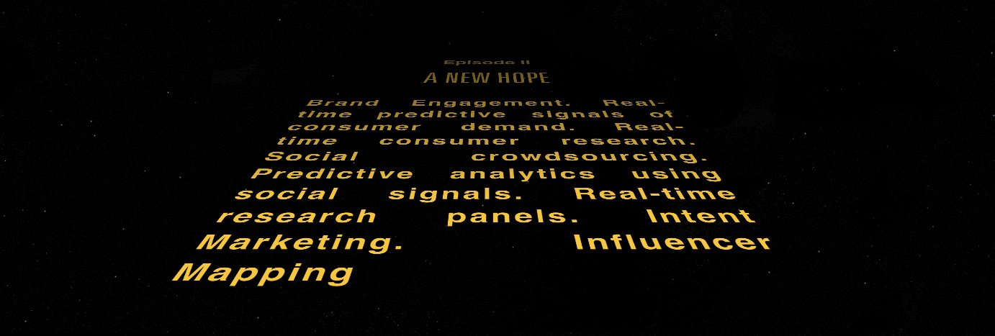
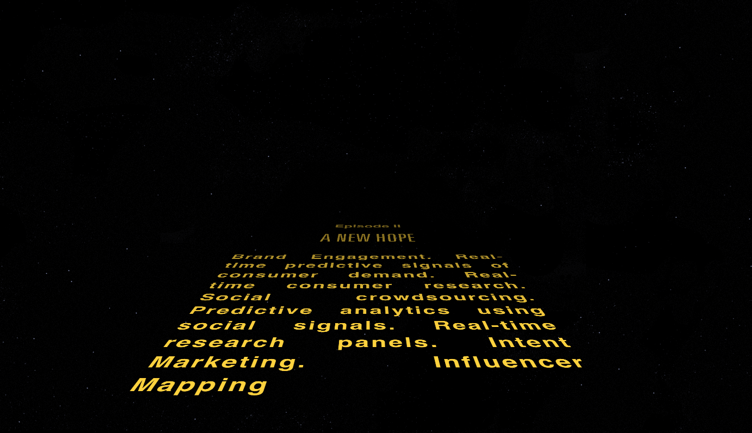
Data has unlimited business potential

Slide 10
Intent Measurement with Machine Learning
Research Panels applied to social data
Predictive Power of Social

Slide 11
Intent Measurement with Machine Learning
Research Panels applied to social data
Predictive Power of Social

Slide 12
Negative
Neutral
Positive

Slide 13
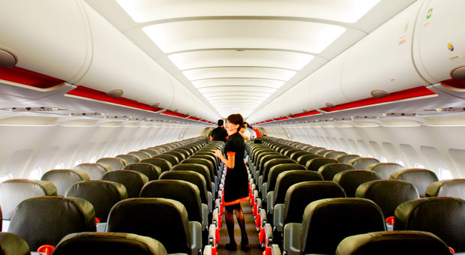
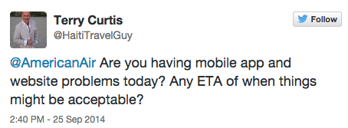
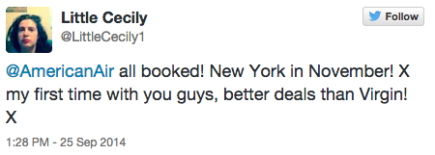
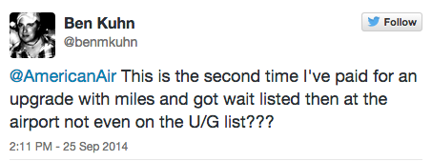
Sentiment is not actionable
Query
Rave
Rant

Slide 14
Intent Measurement with Machine Learning
Actionable Internet Mentions
Rant
Rave
Query
Feedback
Urgent
Lead
Train an algorithm by example

Slide 15
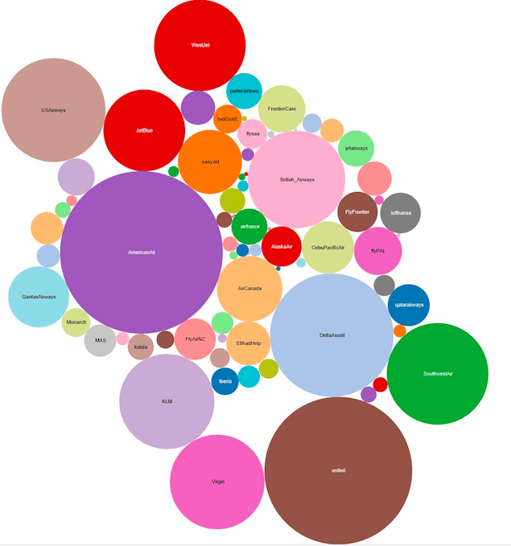
BA
AmericanAir
AmericanAir
Getting all the conversation
They have largest “share of voice”
United

Slide 16
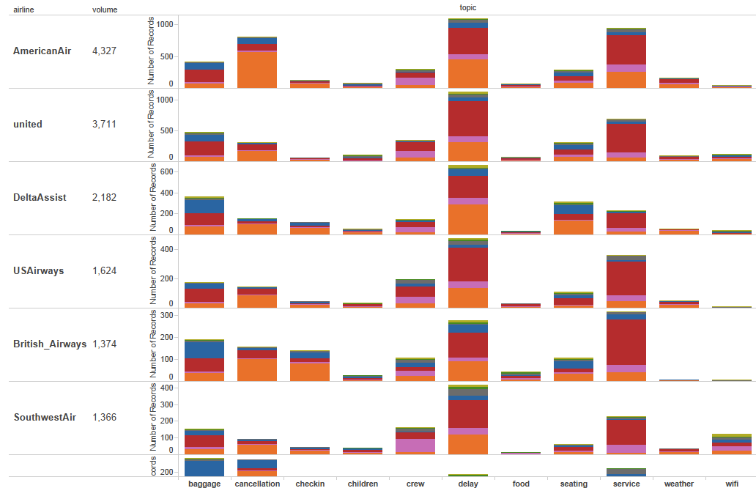
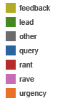
AmericanAir urgent cancellations
AmericanAir
United
BA related rants on customer service
BA
Baggage
Delay
Service

Slide 17
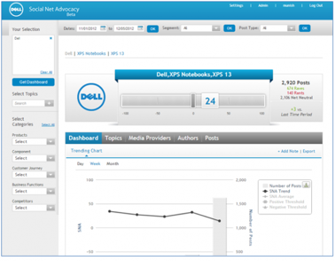
Dell maps social data to product and intent feedback
38,000 Social posts every day on Dell
Measure Net Promoter Score across 37 Product-Lines
150 Metrics influence Social Advocacy Score
Actionable insights drive 38% increase in product purchase loyalty

Slide 18
Intent Measurement with Machine Learning
Research Panels applied to social data
Predictive Power of Social

Slide 19

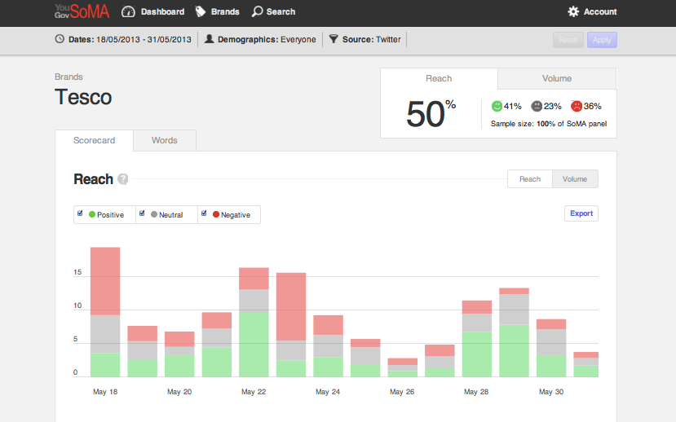

YouGov builds a UK social research panel
Recruited UK Research Panel
Remove Demographic Bias
Real-time research to drive traditional research development

Slide 20
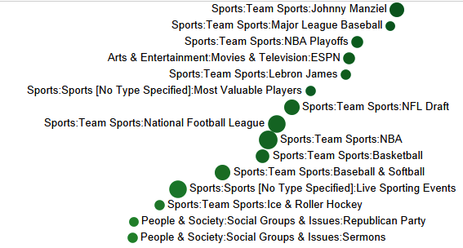
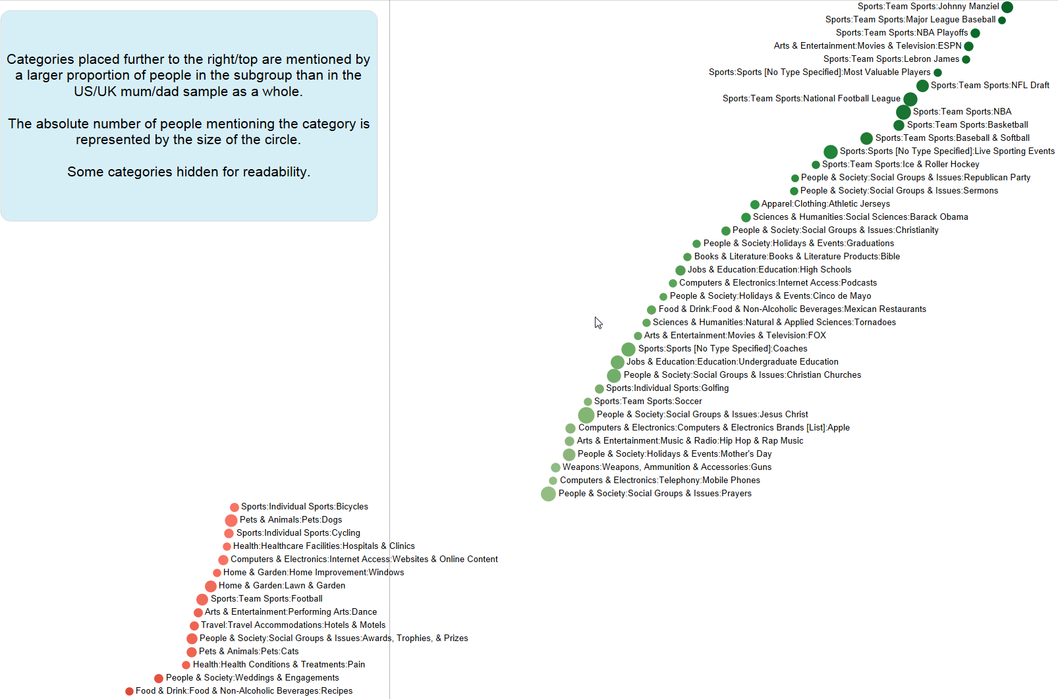
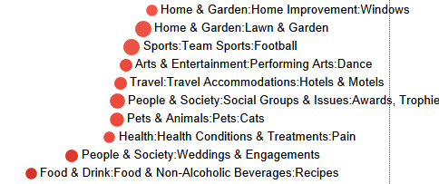
What’s uncommonly common amongst US dads
Build your own panel
Over-under indexed topics

Slide 21
Intent Measurement with Machine Learning
Research Panels applied to social data
Predictive Power of Social

Slide 22


Predictive Business intelligence
Transactions
Interactions
Correlate to create predictive models

Slide 23
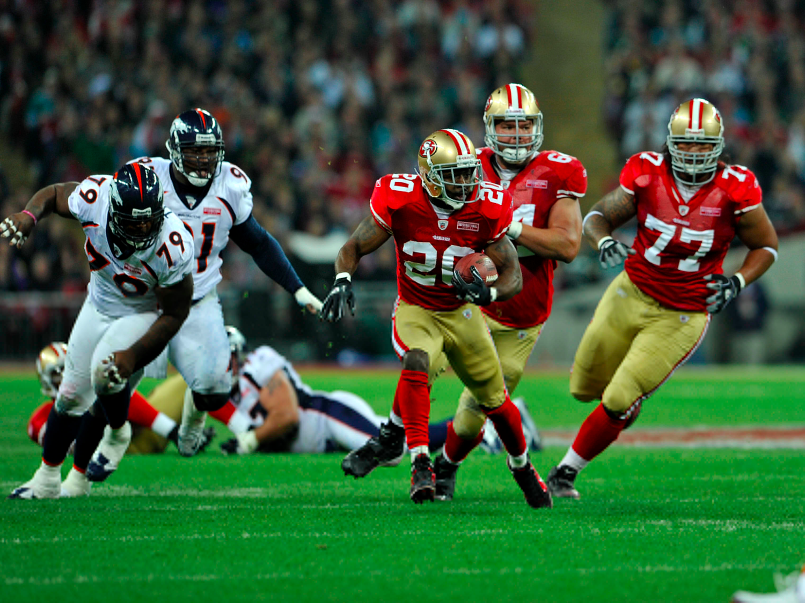
Measuring the roar of the crowd

Slide 24

How much money should you spend on advertising your film?

Slide 25
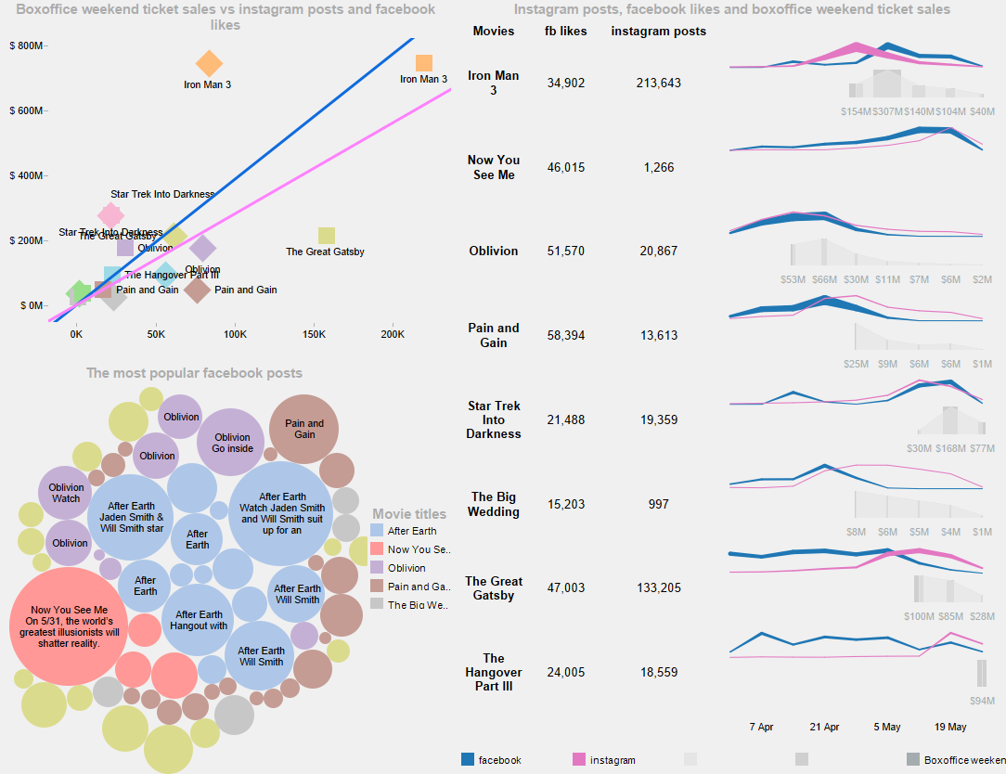
Correlate Box Office Revenues with Social Interest & Intent.
Create Predictive Models based on Social Signals

Slide 26
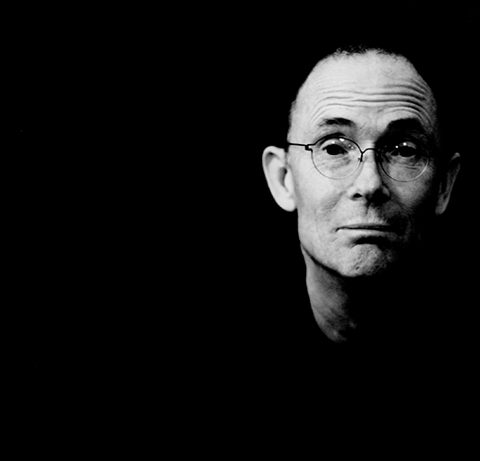
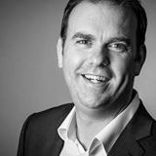
“
The future is already here –
it’s just not evenly distributed.
William Gibson
”
Tim Barker | @timbarker | tim.barker@datasift.com

